Slide 1
Unit 5 Can you？

Slide 2
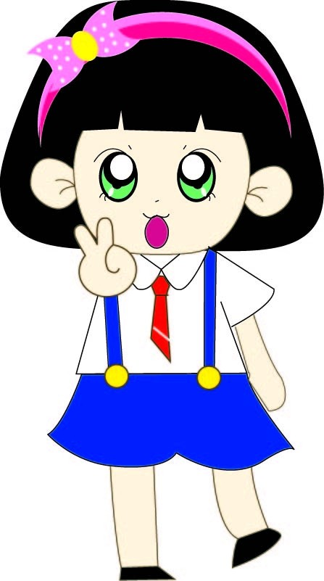
Let's learn new words!

Slide 3
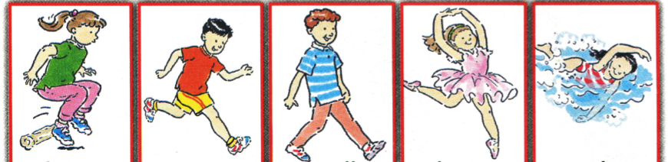
jump run walk dance swim
跳 跑 走 跳舞 游泳

Slide 4
Let's play!
Can you...?
Yes, I can.

Slide 5
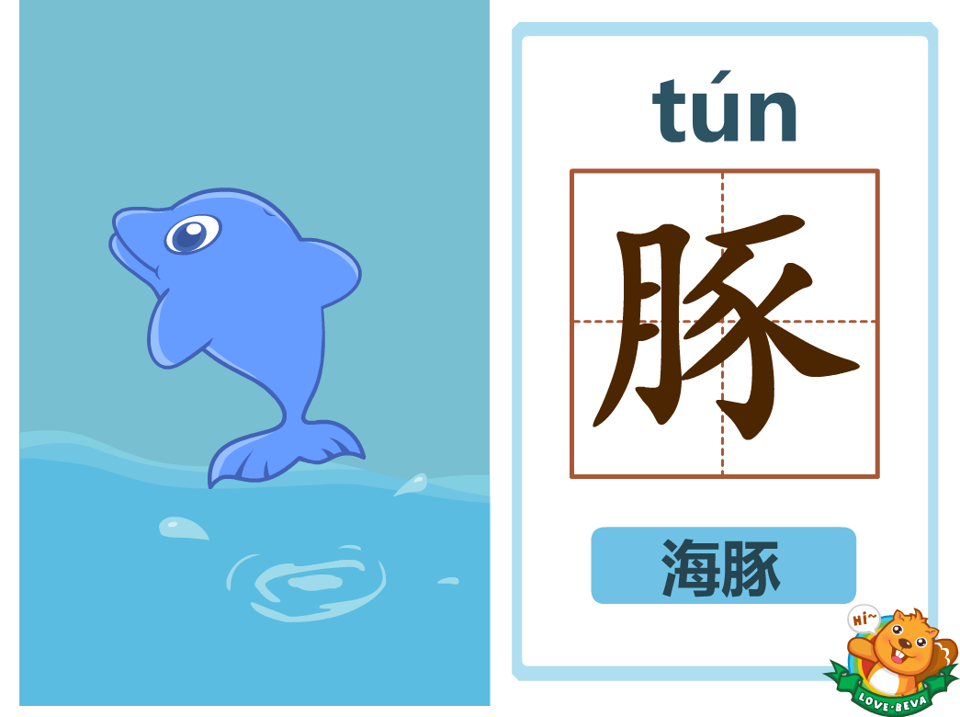

Athlete 1 : Fish
swim
Can you _________?
Yes, I can.

Slide 6
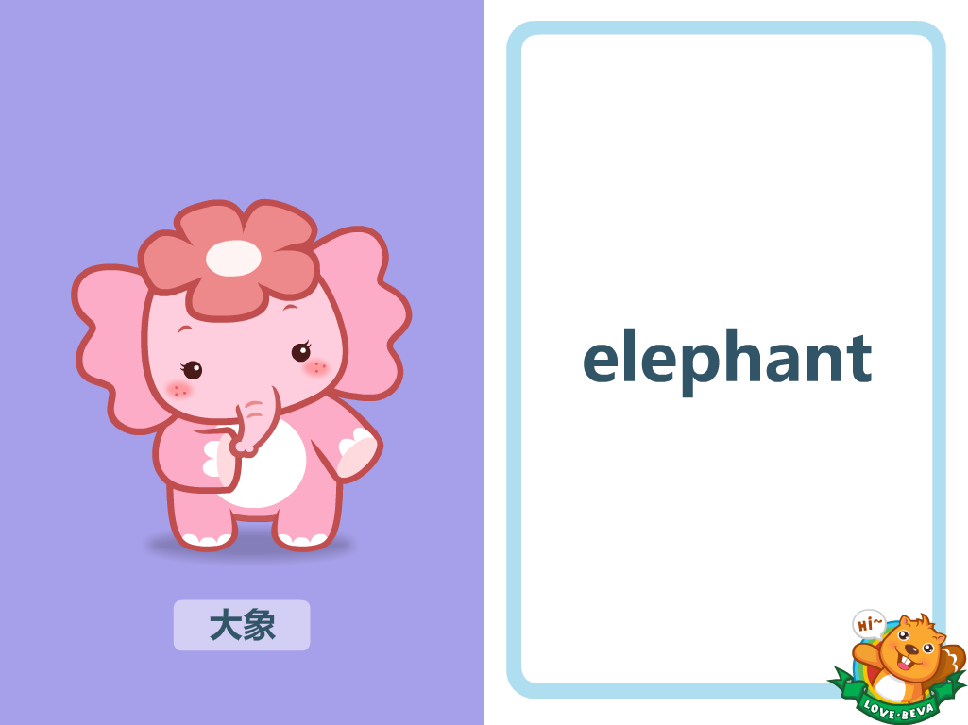
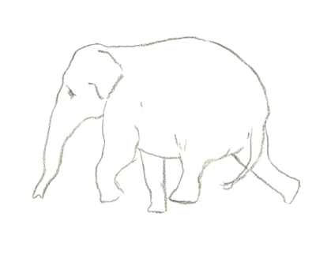

Athlete 2 : Elephant
walk
I can __________ .
Can you walk?
Yes, I can.

Slide 7
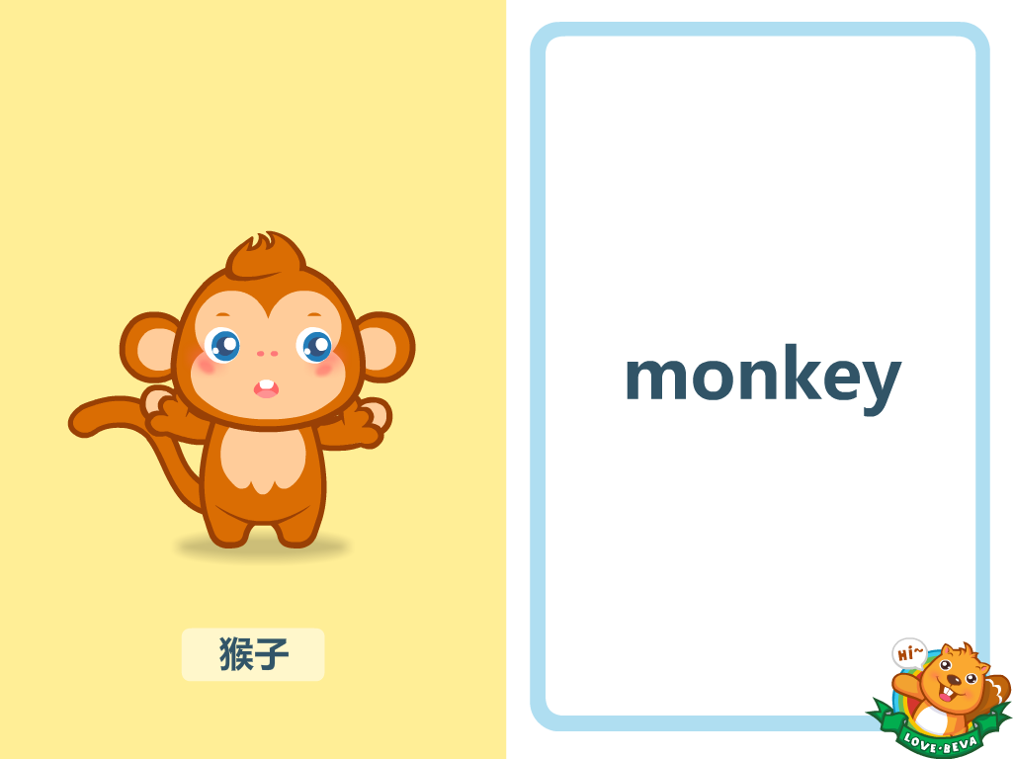


Athlete 3 : Monkey
Can you swim?
No, I can’t.
dance
I can __________ .

Slide 8


Fish, fish, can you swim ?
Yes, I can.

Slide 9
No, I can’t.
I can dance.
Monkey, monkey, can you swim ?

Slide 10
Let's talk!

Slide 11
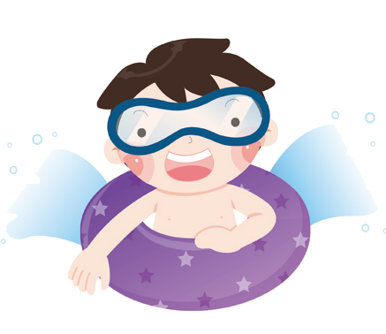

I can swim.

Slide 12
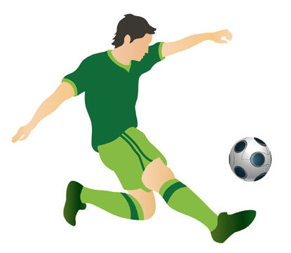
I can play football.

Slide 13
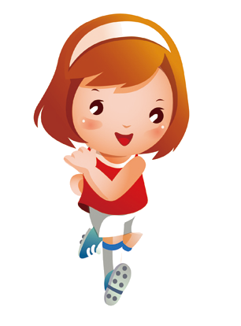
I can run.

Slide 14


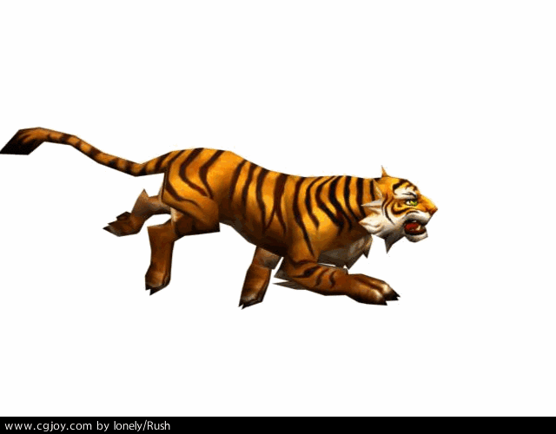
Let’s chant.
Jump, Jump, I can jump.
Run, run, I can run.
Walk, walk, I can walk.
Swim, swim, I can swim.
Dance, dance, I can dance.

Slide 15



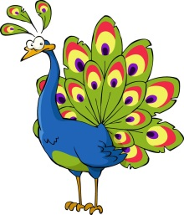

What can you do?
jump
swim
run
walk
dance
✔
✔
✔
✔
✔
✔
✔
✔
✔
✔
✔

Slide 16






I can ________ .
请小朋友们按照顺序排好队！
dance
swim
jump
run
walk

Slide 17
See you!

